Slide 1

Software Simulation of an Insulin And Glucagon Pump
Group E
Ahmed, Asad 1321474
Girdhar, Shubham 1323003
Shaikh, Safir Mohammad 1322554
Usmani, Faiz 1323197
Yelpale, Kshitij 1322509
Project Supervisor:
Prof. Dr. rer.nat. Dipl. Phys. Matthias F. Wagner

Slide 2
Project Scope
Intent - To study and replicate the human body's blood glucose behavior and simulate an Insulin-Glucagon pump that works autonomously to make sure that the blood glucose levels remain in safe range.
System design - Web application from the perspective of a patient.
Safety and security aspects - alert messages, email and user authentication.

Slide 3
Functional Requirements
Register/login
Monitor blood glucose level
BGL above/below safe limit:
- Hormone selected
- Dosage calculated and injected
Hormone reservoirs maintained and updated
Battery displayed

Slide 4
Safety Requirements
Email verification for user registration
Appropriate alert messages/email
- Glucose level is critical
- Insulin/glucagon reservoir low
- Battery low

Slide 5
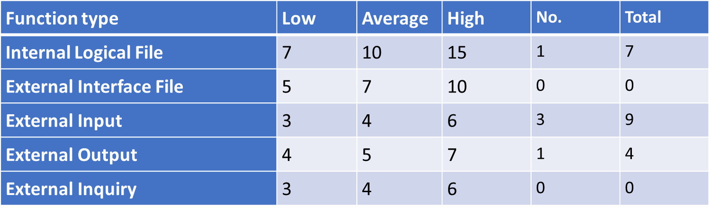
COCOMO 2
We used Intermediate COCOMO to calculate the cost estimation for our project. Intermediate COCOMO takes into account personal and hardware factors into account which are known as “Cost Driver Attributes”.
Calculating Unadjusted Functional Points (UFP)
=20
Calculating SLOC
JAVA(Spring Boot for Backend) and Javascript(Angular 6 for frontend) are chosen as our programming languages. Language Factor (LOC per function point is around 300 average for both.)
So Lines of Code = 20*300 = 6000. Converting SLOC into KLOC by dividing it by 1000 = 6000/1000 = 6
Notes:
When conducting research, it is easy to go to one source: Wikipedia. However, you need to include a variety of sources in your research. Consider the following sources:
Who can I interview to get more information on the topic?
Is the topic current and will it be relevant to my audience?
What articles, blogs, and magazines may have something related to my topic?
Is there a YouTube video on the topic? If so, what is it about?
What images can I find related to the topic?

Slide 6
COCOMO 2
Calculating Effort Adjustment Factors using Cost Drivers (Factors with ratings)
Product Attributes : Required Software Reliability : 1.40, Size of Application Database : 0.94, Complexity of the product : 0.70
Hardware Attributes : Run-time Performance Constraints : 1, Memory Constraints : 1, Volatility of the Virtual Machine environment : 1, Required Turnabout time : 1
Personnel Attributes : Analyst Capability : 1, Application Experience : 1, Software Engineer Capability : 1, Virtual Machine Experience : 1.1, Programming Language Experience : 1
Project Attributes : Application of Software Engineering Methods : 0.82, Use of Software Tools : 0.83, Required Development Schedule : 1.08
EAF = Multiplication of the chosen factor values = 0.74
Notes:
When conducting research, it is easy to go to one source: Wikipedia. However, you need to include a variety of sources in your research. Consider the following sources:
Who can I interview to get more information on the topic?
Is the topic current and will it be relevant to my audience?
What articles, blogs, and magazines may have something related to my topic?
Is there a YouTube video on the topic? If so, what is it about?
What images can I find related to the topic?

Slide 7
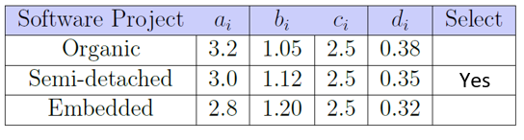
COCOMO 2
Calculating Persons per month and Development time
As our development team is a mixture of experienced and inexperienced staff. The project may contain some unfamiliar aspects that need to be developed, so we identified ourselves as semi-detached.
Effort applied = a^{i}(KLOC) ^{bi} * EAF [man-months] = 3.0 * (6) ^{1.12} * 0.74 = 16.5 [man-months]
Development Time = c^{i} (Effort Applied) ^{di} [months] = 2.5 * (15.4) ^{0.35} = 6.7 months
People required = Effort Applied / Development Time [count] = 16.5/6.7 = 2.5 people
As we are a team of 5 people.
So, Development Time = 16.5/5 = 3.3 months
We calculated this at the start of December, and we had approximately 2.5 months to develop our application. So keeping that in mind we decided to develop only the core functionality of a patient’s use case.
Notes:
When conducting research, it is easy to go to one source: Wikipedia. However, you need to include a variety of sources in your research. Consider the following sources:
Who can I interview to get more information on the topic?
Is the topic current and will it be relevant to my audience?
What articles, blogs, and magazines may have something related to my topic?
Is there a YouTube video on the topic? If so, what is it about?
What images can I find related to the topic?

Slide 8
Process Model (1/3)
Agile iterative approach is most suited to deal with development of complex technical systems and change management, but the development of a safety critical system is governed strictly by safety standards. So, the process model we have chosen for our project is Agile Scrum with some safety incorporations according to standard IEC-61508 [1].
Team organization - Self-organizing cross functional scrum team. Each team member worked as a designer, developer or tester depending on the phase of the sprint. Benefit - complete capacity utilization of team.

Slide 9
Process Model (2/3)
The project was split into sprints of 2 weeks each. Phases in every sprint:
Sprint planning
Requirement analysis
Design
Implementation
Testing
Sprint retrospective
Backlog review
Demo/presentation
Bi-weekly scrum meetings

Slide 10
Process Model (3/3)
Mapping agile scrum to IEC-61508
Difficulties in implementing AGILE for the development of SCS (and how we tackled these):
Agile Scrum | IEC - 61508
Product backlog | Software safety requirements
Backlog review and sprint retrospective | System safety validation and verification
Difficulty | Solution
Everybody has license to change anything | Proper monitoring, review process, verification and validation
Working software over comprehensive documentation | Comprehensive documentation sprint wise, traceability

Slide 11
Milestones and Project Timeline

Slide 12
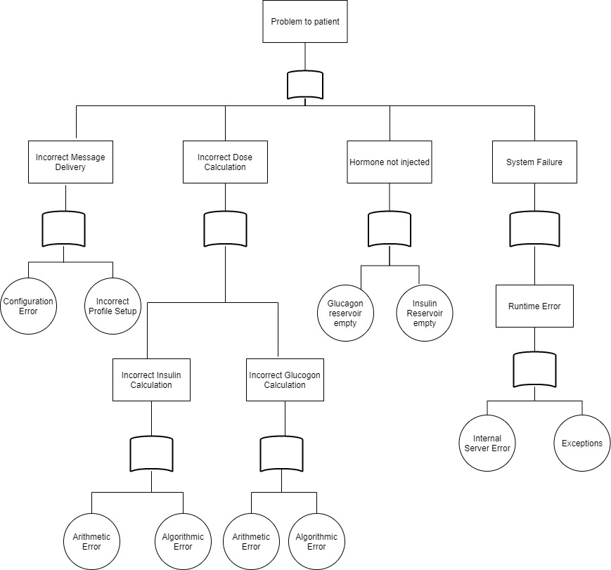
HAZARD ANALYSIS
FAULT TREE ANALYSIS
Notes:
When conducting research, it is easy to go to one source: Wikipedia. However, you need to include a variety of sources in your research. Consider the following sources:
Who can I interview to get more information on the topic?
Is the topic current and will it be relevant to my audience?
What articles, blogs, and magazines may have something related to my topic?
Is there a YouTube video on the topic? If so, what is it about?
What images can I find related to the topic?

Slide 13
STAMP Approach (1/5)
Recognizing System Hazards
It could also happen that insulin/glucagon is selected but problem occurs in its distribution within the time and amount
Reservoirs of Insulin or Glucagon can get empty.
Battery can be drained out.
In calculation of Insulin and Glucagon Arithmetic or Algorithmic errors can occur.
In a single instance, more than required amount of hormone can get injected.

Slide 14
STAMP Approach (2/5)
Recognizing System Level Safety related to Requirements and Constraints
Only applicable to Insulin/Glucagon dose calculation.
No sensors would be involved as we have built a software simulation.
For authentication we have use JSON web token
System should display appropriate error and warning messages when required.
User is alerted in the event of low pump battery, low insulin and glucagon level in reservoirs.

Slide 15
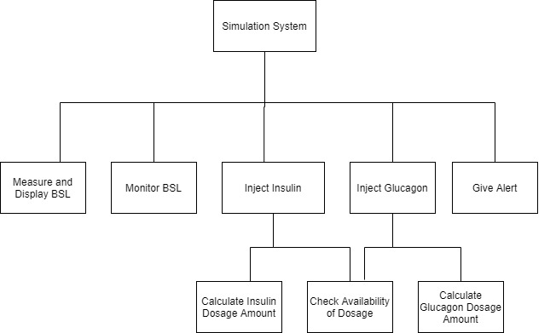
STAMP Approach (3/5)
Basic System Control Structure

Slide 16
STAMP Approach (4/5)
Recognizing inadequate control actions that could lead to a hazardous system state
System could go in hazardous state due to runtime errors.
Empty reservoirs of Glucagon/Insulin could lead to hazardous state.
Arithmetic or Algorithmic errors occurs during calculation of Insulin or Glucagon.
If Configurations are not done properly the system could move towards unsafe state.

Slide 17
STAMP Approach (5/5)
Determining how Constraints could be violated and how we can eliminate or reduce the probability of Hazards in our project
An alert message will be sent to patient’s contact in case of blood sugar level stays for longer period of time over the threshold.
If only 10% of insulin or glucagon is left then email will be sent immediately so in this way, we are handling this to go in a hazardous state.
We inject the hormones insulin/glucagon automatically through auto mode.

Slide 18
Safety Plan
Software Simulation System continuously monitors Pump's Battery Level and Reservoir's Status and alerts Patient in case of Low Battery and Reservoirs becoming empty.
While entering the details, the Patient should also provide his/her dependent's details.
The System will send an email to the dependent if any exception occurs with proper details. The exceptions can be:
When Reservoirs are less than 10 percent.
Injected dosage doesn't work when BSL stays beyond threshold longer than a particular time.
Notes:
When conducting research, it is easy to go to one source: Wikipedia. However, you need to include a variety of sources in your research. Consider the following sources:
Who can I interview to get more information on the topic?
Is the topic current and will it be relevant to my audience?
What articles, blogs, and magazines may have something related to my topic?
Is there a YouTube video on the topic? If so, what is it about?
What images can I find related to the topic?

Slide 19

Design
Star UML
Source: Star UML[2]
Notes:
When conducting research, it is easy to go to one source: Wikipedia. However, you need to include a variety of sources in your research. Consider the following sources:
Who can I interview to get more information on the topic?
Is the topic current and will it be relevant to my audience?
What articles, blogs, and magazines may have something related to my topic?
Is there a YouTube video on the topic? If so, what is it about?
What images can I find related to the topic?

Slide 20
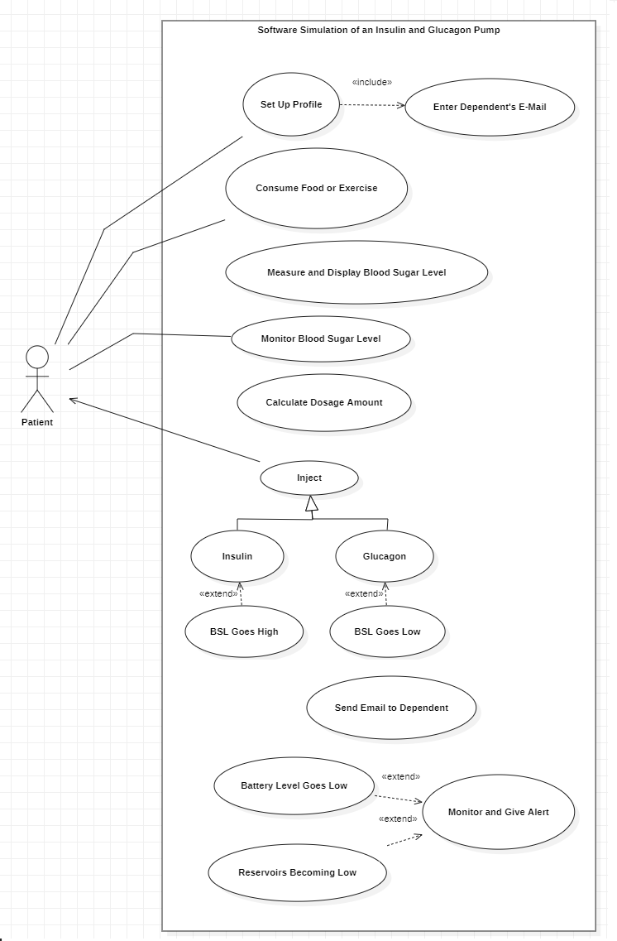
Use Case Diagram
Use Cases:
Set Up Profile
Consume Food or Exercise
Measure and Display Blood Sugar Level
Monitor Blood Sugar Level
Calculate Dosage Amount
Inject Insulin/Glucagon
Send Email to Dependent
Monitor and Give Alert
Notes:
When conducting research, it is easy to go to one source: Wikipedia. However, you need to include a variety of sources in your research. Consider the following sources:
Who can I interview to get more information on the topic?
Is the topic current and will it be relevant to my audience?
What articles, blogs, and magazines may have something related to my topic?
Is there a YouTube video on the topic? If so, what is it about?
What images can I find related to the topic?

Slide 21
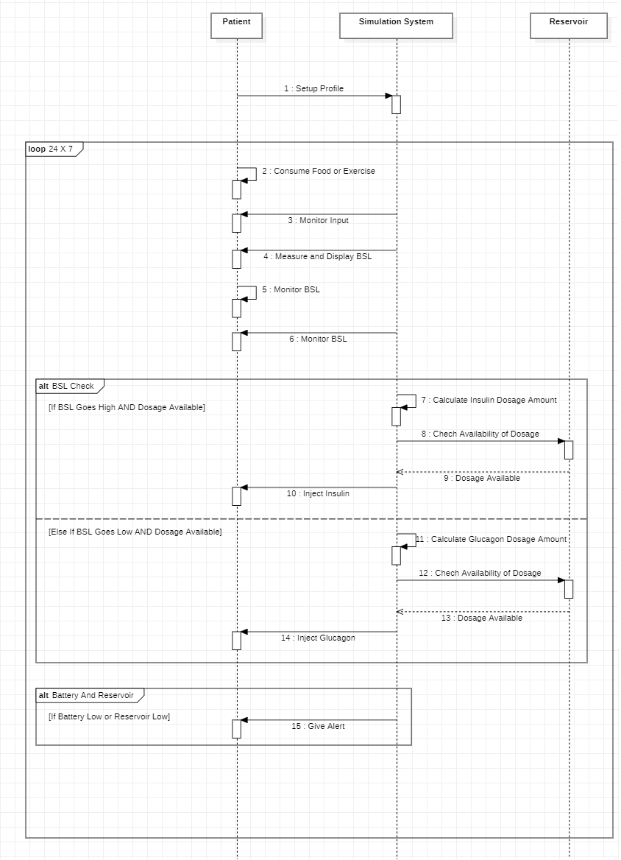
Sequence Diagram
Notes:
When conducting research, it is easy to go to one source: Wikipedia. However, you need to include a variety of sources in your research. Consider the following sources:
Who can I interview to get more information on the topic?
Is the topic current and will it be relevant to my audience?
What articles, blogs, and magazines may have something related to my topic?
Is there a YouTube video on the topic? If so, what is it about?
What images can I find related to the topic?

Slide 22
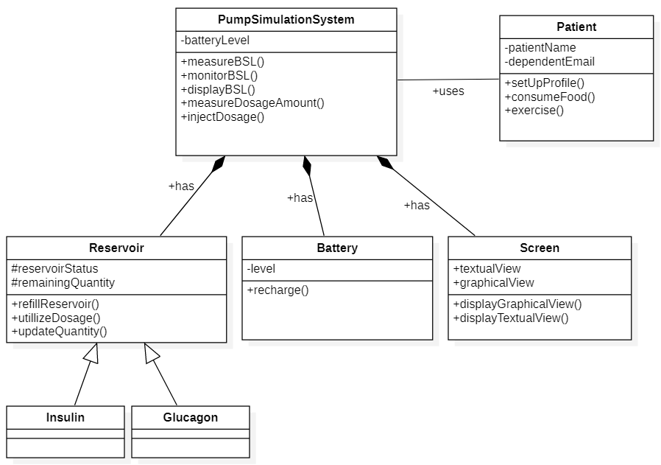
Class Diagram
Notes:
When conducting research, it is easy to go to one source: Wikipedia. However, you need to include a variety of sources in your research. Consider the following sources:
Who can I interview to get more information on the topic?
Is the topic current and will it be relevant to my audience?
What articles, blogs, and magazines may have something related to my topic?
Is there a YouTube video on the topic? If so, what is it about?
What images can I find related to the topic?

Slide 23
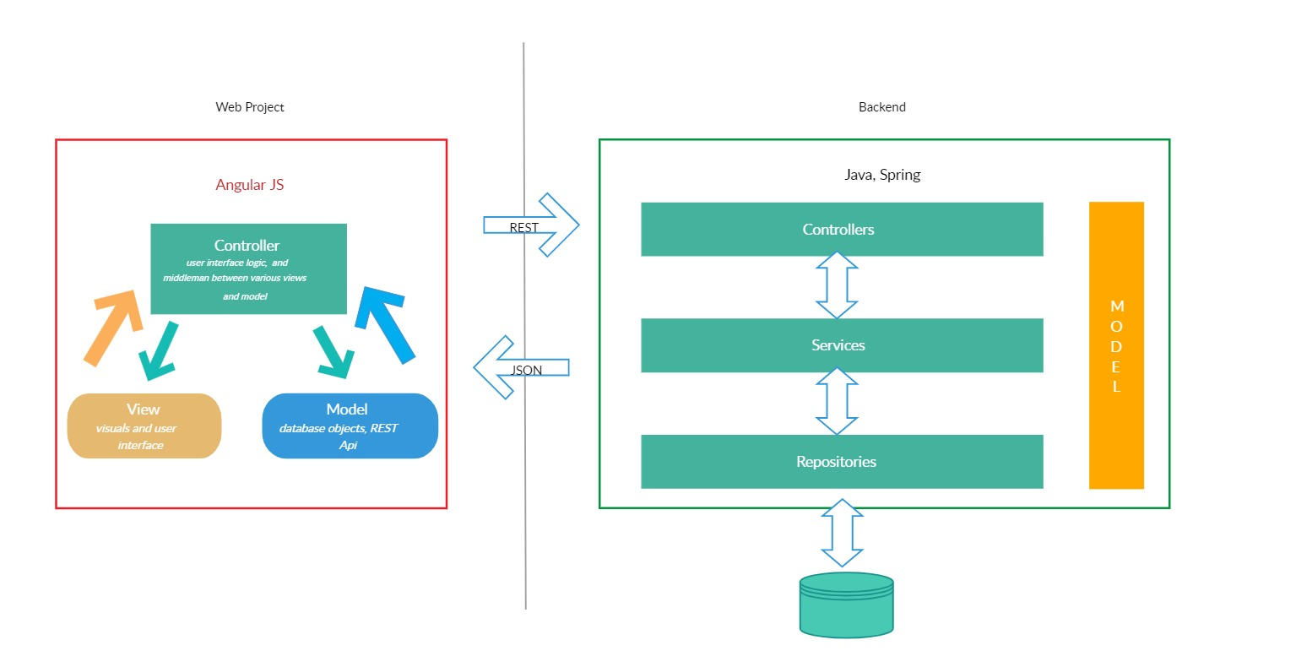
Architecture Diagram
Source: AngularJS - Spring MVC Architecture [3]

Slide 24

Mathematical Model
After referring research paper[4], here are 2 Ordinary Differential Equations.
Where
C – concentration of carbohydrates in stomach
G – concentration of glucose in the blood
G₀ – initial value at t = 0
k₁ – glycemic index(how quickly food is digested)
k₂ – insulin injection rate (how quickly insulin is released)

Slide 25


Solution
After substituting the values of constants, equation is
The safe range of blood glucose level is from 70 – 120 mg/dL

Slide 26
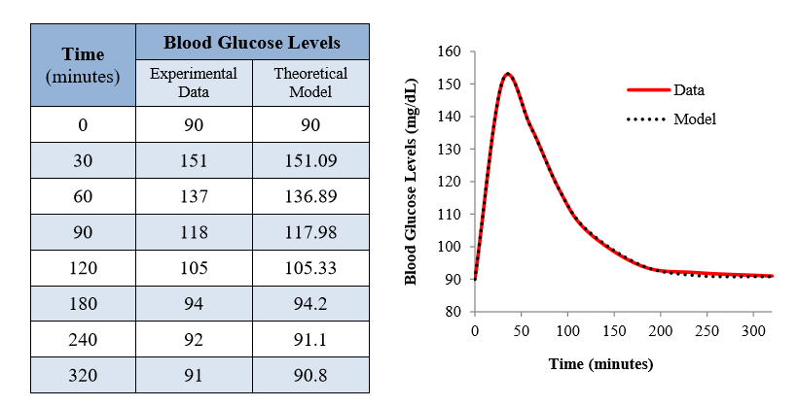
Comparison

Slide 27
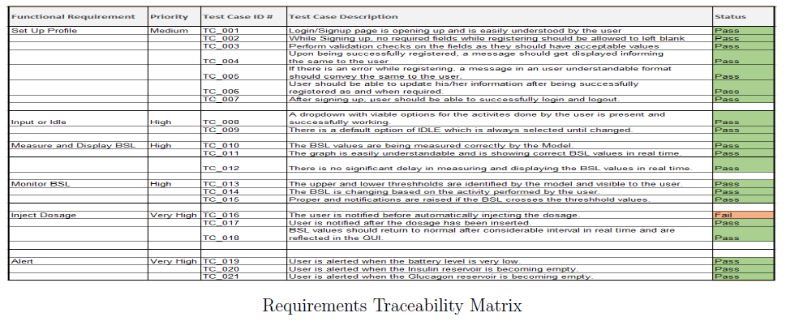
Verification and Validation
Requirement Traceability Matrix (zoomed)
Notes:
When conducting research, it is easy to go to one source: Wikipedia. However, you need to include a variety of sources in your research. Consider the following sources:
Who can I interview to get more information on the topic?
Is the topic current and will it be relevant to my audience?
What articles, blogs, and magazines may have something related to my topic?
Is there a YouTube video on the topic? If so, what is it about?
What images can I find related to the topic?

Slide 28
Demo

Slide 29
Future Scope
Multiple perspective like Admin, Doctor.
Manual mode
Sound based alerts
Calculation of BSL on other factors like age, weight, medical history etc

Slide 30
Conclusion

Slide 31
References
[1] Zhensheng Guo, Claudia Hirschmann: \An Integrated Process for Developing Safety-critical Systems using Agile Development Methods". Available: https://pdfs.semanticscholar.org/f4e5/5be15193e5cea38a28106c29df6853454aed.pdf [Access date: 09/02/2020]
[2] Star UML, Available: http://staruml.io/ [Access date: 24/02/2020]
[3] AngularJS - Spring MVC Architecture, Available: https://creately.com/diagram/example/ibne2ccj2/AngularJS%20-%20Spring%20MVC%20Architecture [Access date: 24/02/2020]
[4] Carlos Estela: \Blood Glucose Levels". Available: https://scholarcommons.usf.edu/ujmm/vol3/iss2/12/ [Access date: 09/02/2020]
Notes:
When conducting research, it is easy to go to one source: Wikipedia. However, you need to include a variety of sources in your research. Consider the following sources:
Who can I interview to get more information on the topic?
Is the topic current and will it be relevant to my audience?
What articles, blogs, and magazines may have something related to my topic?
Is there a YouTube video on the topic? If so, what is it about?
What images can I find related to the topic?

Slide 32


